Slide 1
Diagnosis of Breast Cancer
Saurabh Khodake
Saurabh Sharma
Piyush Narang
Gaurav Gola
Kallol Samanta
Pramit Patra

Slide 2
PROBLEM STATEMENT
To predict the type of tumor :
i) Benign(Non cancerous)
OR
ii) Malignant(Cancerous)

Slide 3
INTRODUCTION
Breast cancer is most common form of cancer in Women
It represents about 12% of all new cancer cases and 25% of all cancers in women
Rates for breast cancer vary worldwide, depending on health care services in nations
This study is based on tumor study from US state of Wisconsin

Slide 4
Data Obtained For STUDY
3-D digitized images of breast mass(lump) used for extracting information
Real-valued features are computed for each cell nucleus
Grouped into 3 types: Mean, Standard Error, Worst
32 total variables like:
-Radius
-Area
-Smoothness etc.
To determine type of tumor i) Benign ii) Malignant

Slide 5
Exploratory Data Analysis
500+ records
No missing values.
Type of variables - Only Diagnosis Variable is “Categorical” Other 31 variables are “Numerical”.
Data split into 70:30 ratio for training & testing resp.
Since each variable has different variance, data is scaled

Slide 6
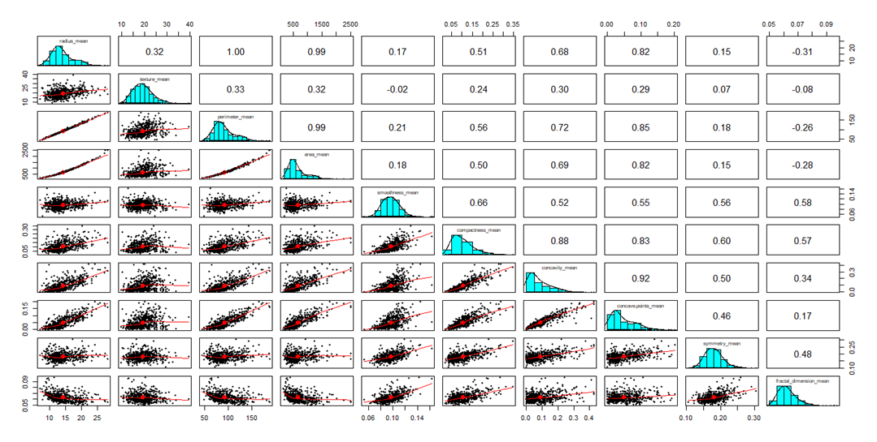
Collinearity Graph
Collinearity among 10 variables

Slide 7
Principal Component Analysis
We used PCA for:
Dimension Reduction
  To reduce dimensions with minimal loss of information
  66% reduction in features
To Reduce Multicollinearity
  To eliminate covariance among explanatory variables

Slide 8
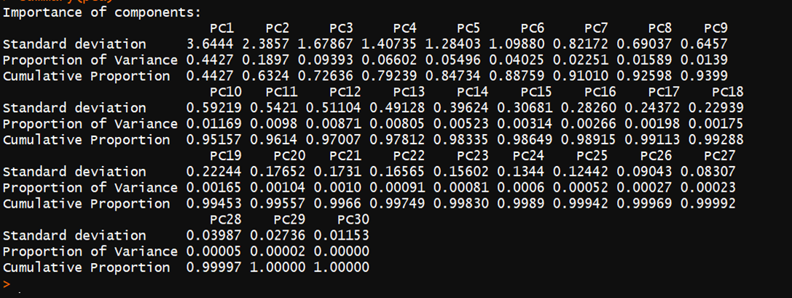
PCA Implementation
First 10 components accounts for 95% of total variance
First 15 components accounts for 98% of total variance

Slide 9
Model Building
8 different algorithms were trained and tested
    Neural Network
    Logistic Regression
    K-nearest neighbor
    Random Forest
    Learning Vector Quantization
    Linear Discriminant Analysis
    Logistic Model Trees
    Stochastic Gradient Boosting
Iterated over 50 times
Average performance was recorded

Slide 10
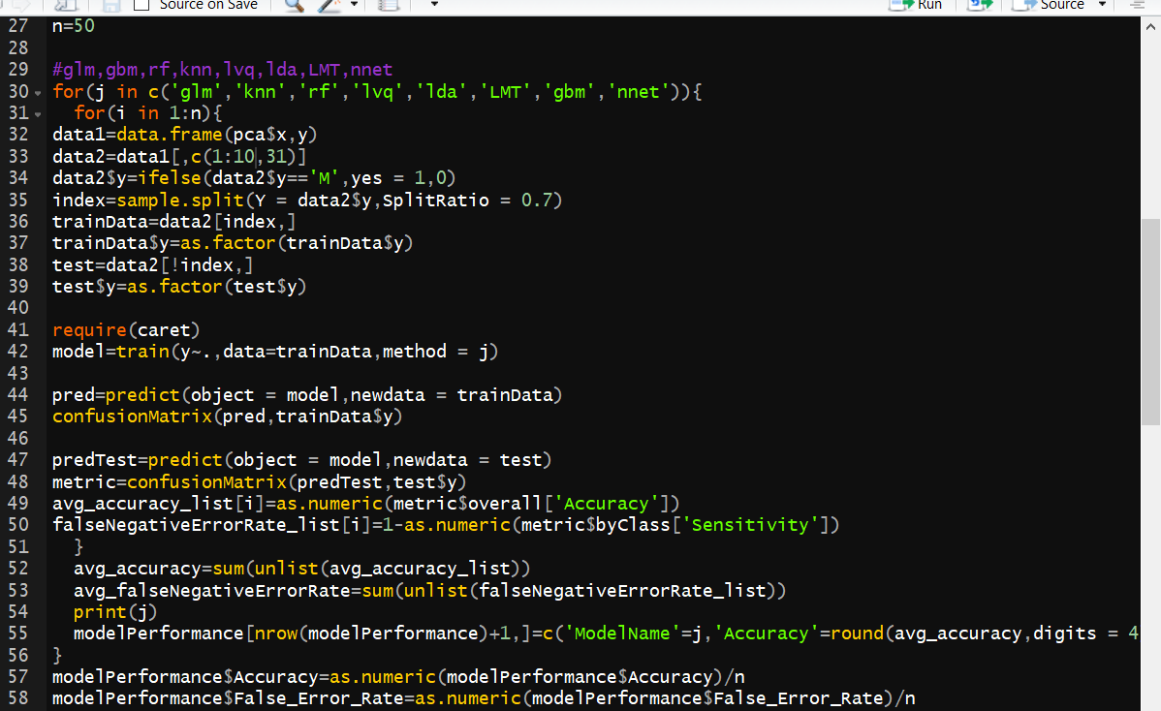
Model Building

Slide 11
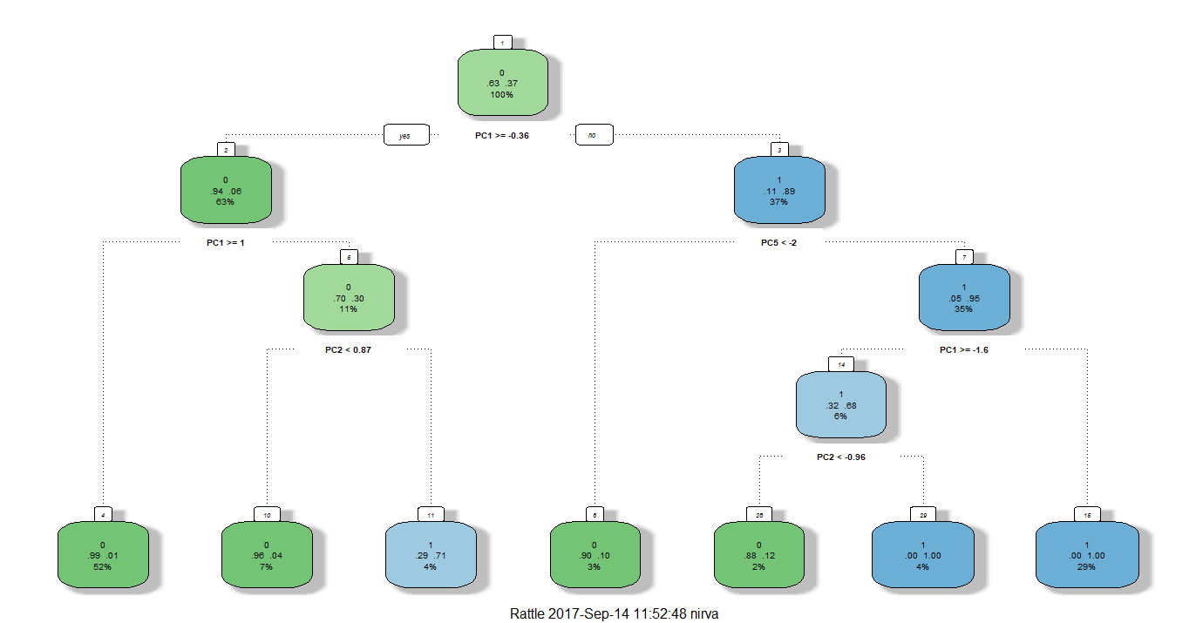
Decision Tree
B
M

Slide 12
Performance Indicators
2 most important parameters for judgement here are
i) Accuracy (classified correctly)
ii) False Negative Error rate (Predicted an ill person healthy)

Slide 13
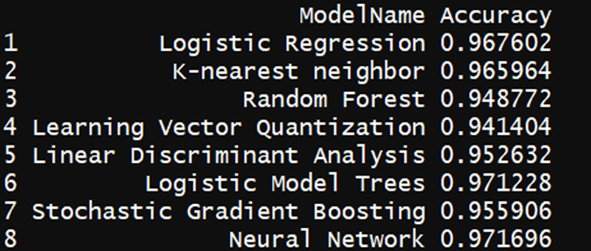
Accuracy with 10 PCA components
Neural Network is the best performing model with 97.26% accuracy.

Slide 14
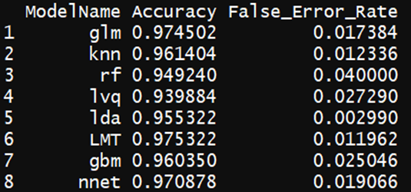
False Negative Error-Rate
This calculates the error when patient with cancer is predicted as healthy
False negative error rate of Linear Discriminant Analysis is the lowest

Slide 15
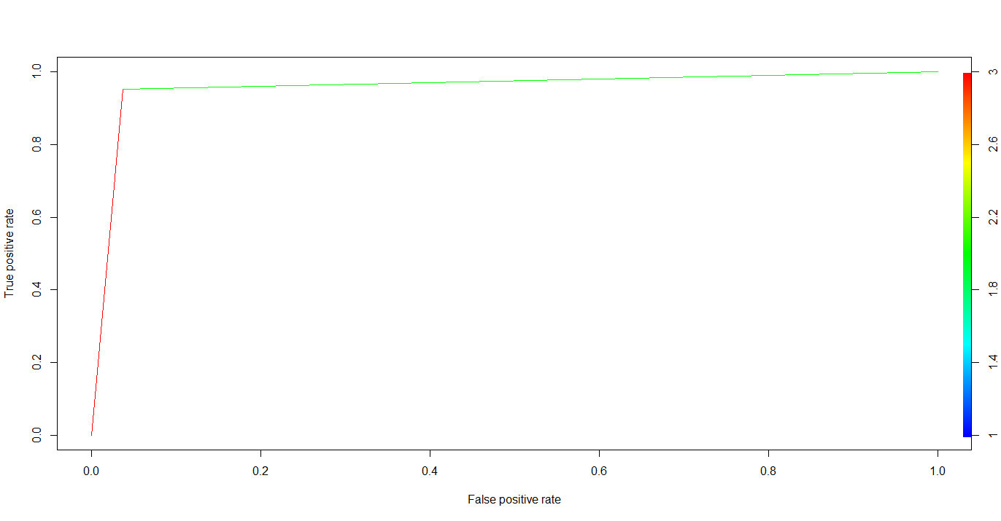
ROC Curve

Slide 16
Way Forward
We also performed PCA with 15 components, very marginal improvement in accuracy
Depending on priority of accuracy or False negative error rate, Neural network or Linear Discriminant Analysis can be chosen
Ensembling of models can be done to improve accuracy
Git Hub link: Click here

Slide 17


